Slide 1
CSCI 2400: Performance Lab Recitation
TA: Sandesh Dhwaskar Sathyanarayana
Fall 2019

Slide 2
Improving Performance
Procedure to convert string to lower case :
void lower(char *s)
{
size_t i;
for (i = 0; i < strlen(s); i++)
if (s[i] >= 'A' && s[i] <= 'Z')
s[i] -= ('A' - 'a');
}
Move call to strlen outside of loop.
Since result does not change from one iteration to another.
void lower(char *s)
{
size_t i;
size_t len = strlen(s);
for (i = 0; i < len; i++)
if (s[i] >= 'A' && s[i] <= 'Z')
s[i] -= ('A' - 'a');
}

Slide 3
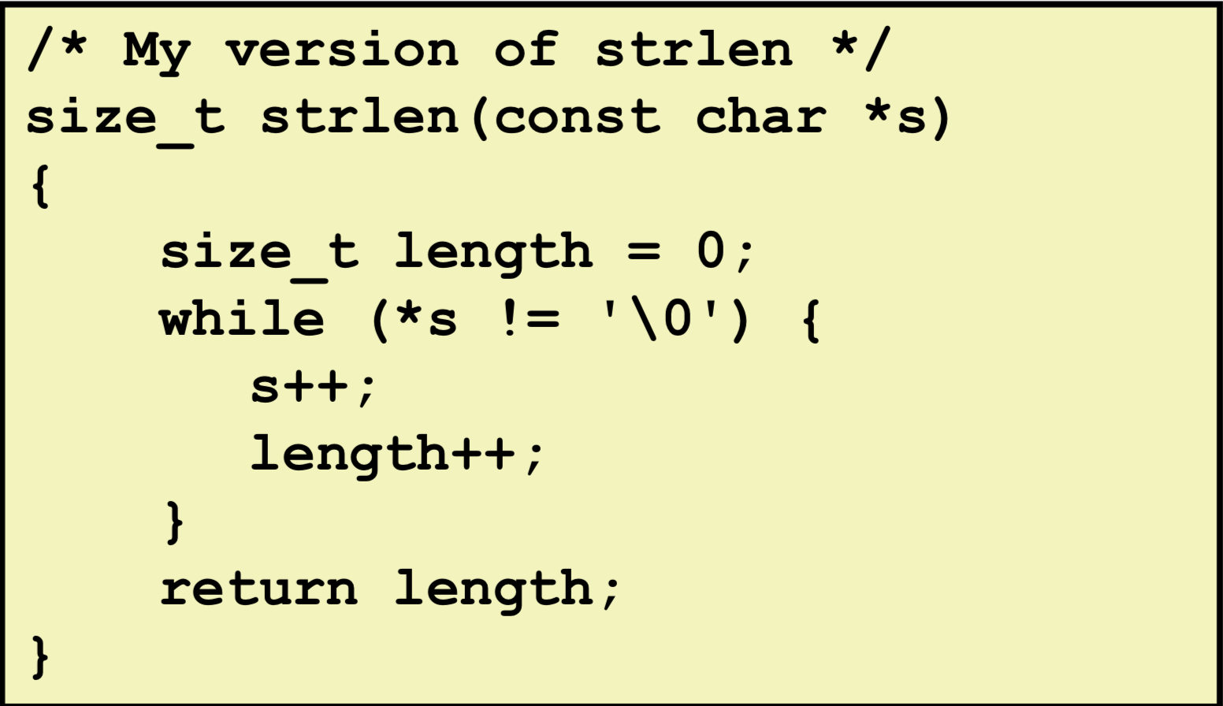
Function to calculate the length of string :
Move call to strlen outside of loop.
Since result does not change from one iteration to another.

Slide 4
Locality
Principle of Locality: Programs tend to use data and instructions with addresses near or equal to those they have used recently
Temporal locality: (ex. Loops)
Recently referenced items are likely to be referenced again in the near future
Spatial locality: (ex. Arrays)
Items with nearby addresses tend to be referenced close together in time
Notes:
<number>

Slide 5
Locality Example
sum = 0;
for (i = 0; i < n; i++)
sum += a[i];
return sum;
Data references
Reference array elements in succession (stride-1 reference pattern).
Reference variable sum each iteration.
Instruction references
Reference instructions in sequence.
Cycle through loop repeatedly.
Spatial locality
Temporal locality
Spatial locality
Temporal locality

Slide 6
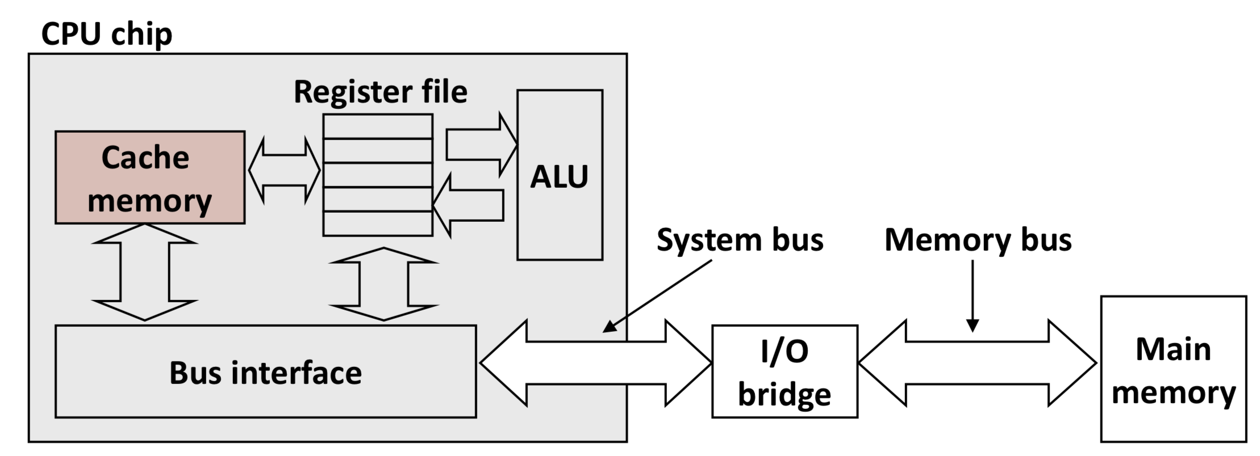
General Cache concepts:
Cache memories are small, fast SRAM-based memories manages automatically in hardware.
Hold frequently accessed blocks of main memory.
CPU looks for data first in cache.

Slide 7
Cache Concepts for Matrix Mul example :
The spatial property of cache allows elements in the same row to be cached.
Stepping through elements in the same row
for(i = 0; i < n; i++)
sum += a[0][i]
Here, miss rate = sizeof(a_{ij})/B, where B is the block size for the cache (32 bytes). For floats it would be 8/32 = 0.25
In case of multiple loops we only consider the innermost loop as it is the most repeated operation.

Slide 8
Cache Concepts for Matrix Mul example :
Stepping through rows in one column
for (i=0;i<n;i++)
sum += a[i][0]
Here, the elements are located in different rows and since n >> size of cache, we can assume miss rate as 1/n ~ 0
This is the case where there is no spatial locality and this should be avoided.
Miss rate = 1 (i.e. 100%)

Slide 9
Matrix Multiplication (ijk)
/* ijk */
for (i=0; i<n; i++) {
for (j=0; j<n; j++) {
sum = 0.0;
for (k=0; k<n; k++)
sum += a[i][k] * b[k][j];
#Take only inner loop elements to compute the cycles.
c[i][j] = sum;
}
}
Inner loop:
(*,j)
(i,j)
(i,*)
A
B
C
matmult/mm.c
Row-wise
Column-
wise
Fixed
Misses per inner loop iteration:
A B C
0.25 1.0 0.0
Block size = 32B (four doubles)

Slide 10
Matrix Multiplication (kij)
/* kij */
for (k=0; k<n; k++) {
for (i=0; i<n; i++) {
r = a[i][k];
for (j=0; j<n; j++)
c[i][j] += r * b[k][j];
}
}
Inner loop:
(i,k)
(k,*)
(i,*)
A
B
C
matmult/mm.c
Fixed
Row-wise
Row-wise
Misses per inner loop iteration:
A B C
0.0 0.25 0.25
Block size = 32B (four doubles)

Slide 11
Matrix Multiplication (jki)
Inner loop:
/* jki */
for (j=0; j<n; j++) {
for (k=0; k<n; k++) {
r = b[k][j];
for (i=0; i<n; i++)
c[i][j] += a[i][k] * r;
}
}
(*,k)
(*,j)
(k,j)
A
B
C
matmult/mm.c
Column-
wise
Fixed
Column-
wise
Misses per inner loop iteration:
A B C
1.0 0.0 1.0
Block size = 32B (four doubles)

Slide 12
Matrix Multiplication
for (i=0; i<n; i++) {
for (j=0; j<n; j++) {
sum = 0.0;
for (k=0; k<n; k++)
sum += a[i][k] * b[k][j];
c[i][j] = sum;
}
}
ijk (& jik):
2 loads, 0 stores
misses/iter = 1.25
for (k=0; k<n; k++) {
for (i=0; i<n; i++) {
r = a[i][k];
for (j=0; j<n; j++)
c[i][j] += r * b[k][j];
}
}
kij (& ikj):
2 loads, 1 store
misses/iter = 0.5
for (j=0; j<n; j++) {
for (k=0; k<n; k++) {
r = b[k][j];
for (i=0; i<n; i++)
c[i][j] += a[i][k] * r;
}
}
jki (& kji):
2 loads, 1 store
misses/iter = 2.0

Slide 13
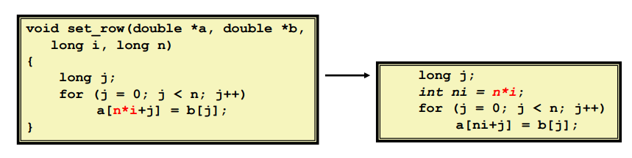
Code Motion
Reduce frequency with which execution performed - if it will always produce the same result - especially move code out of the loop

Slide 14
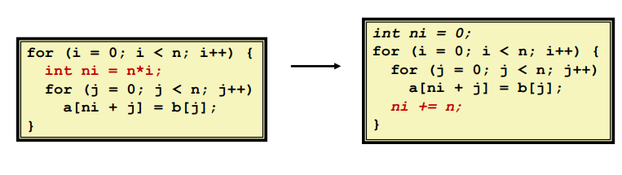
Reduction in strength
Replace costly operations with simpler ones - ex. use shifts or add instead of multiply and divide 16*x --> x << 4

Slide 15
void unroll2a_combine(vec_ptr v, data_t *dest){
long length = vec_length(v);
long limit = length-1;
data_t *d = get_vec_start(v);
data_t x = IDENT;
long i;
/* Combine 2 elements at a time */
for (i = 0; i < limit; i+=2) {
x = (x OP d[i]) OP d[i+1];
}
/* Finish any remaining elements */
for (; i < length; i++) {
x = x OP d[i];
}
*dest = x;
}
Loop unrolling
Unroll by 2x1:
do 2 calc. in 1 iteration
void combine4(vec_ptr v, data_t *dest)
{
long i;
long length = vec_length(v);
data_t *d = get_vec_start(v);
data_t t = IDENT;
for (i = 0; i < length; i++)
t = t OP d[i];
*dest = t;
}
original loop: do 1 calc. in 1 iteration
void unroll2a_combine(vec_ptr v, data_t *dest){
long length = vec_length(v);
long limit = length-1;
data_t *d = get_vec_start(v);
data_t x0 = IDENT;
data_t x1 = IDENT;
long i;
/* Combine 2 elements at a time */
for (i = 0; i < limit; i+=2) {
x0 = x0 OP d[i];
x1 = x1 OP d[i+1];
}
/* Finish any remaining elements */
for (; i < length; i++) {
x0 = x0 OP d[i];
}
*dest = x0 OP x1;
}
Method | Integer |  | Double FP
Operation | Add | Mult | Add | Mult
Combine4 | 1.27 | 3.01 | 3.01 | 5.01
Unroll 2x1 | 1.01 | 3.01 | 3.01 | 5.01
Unroll 2x2 | 0.81 | 1.51 | 1.51 | 2.51
Unroll by 2x2 to reduce sequential dependency
Refer to Lecture 10.pptx for more

Slide 16
Demo
Download and go though the files
Please show them where they can optimize the code?
Please watch video:
https://moodle.cs.colorado.edu/mod/hvp/view.php?id=28862

